Slide 1
ENG4118/5326 - Robotics 4/M Sensors, Actuators and Image capture, processing and analysis
Lecture 2
Kevin Worrall

Slide 2
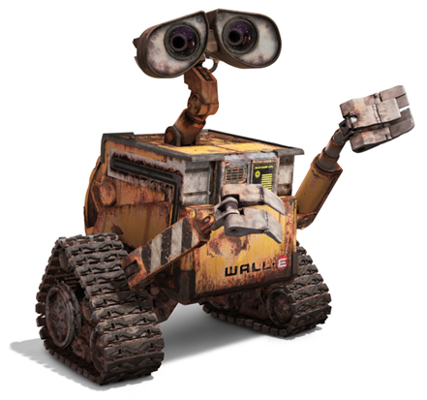
Overview
Sensor Performance Specifications
What are sensor specifications?
Parameters

Slide 3
What is measurement?
We measure everything…
measurement is information about a physical quantity
And to make a measurement we need a sensor
A sensor facilitates the transfer of information about a physical quantity
But measurement is never prefect
Errors are present in the sensing device
The sensing device can change the measurement
Need to understand the sensor specifications

Slide 4
Sensor Specifications
sensor specifications quantify the ability of a sensor to provide measurements of physical variables
This in turn allows you to interpret the output from the sensor and match it to the input (what you are wanting to know about)
To support this sensor manufacturers create datasheets

Slide 5
Datasheet Examples
Temperature Sensor 1:
https://www.ti.com/lit/ds/symlink/lmt86.pdf
Temperature Sensor 2 :
https://www.ti.com/lit/ds/symlink/lm235.pdf
Accelerometer:
https://www.analog.com/media/en/technical-documentation/data-sheets/adxl345.pdf

Slide 6
Physical Principles Applied to Sensors

Slide 7
Sensor Physics
What physical principles are used to allow sensors to react to, then provide an output regarding the environment?
Often what we want to measure must be converted into a different signal
And we often are not measuring the parameter directly but the influence of the parameter
Important to keep this in mind when selecting sensors
What is the most appropriate way to measure the parameter in your system

Slide 8
Sensor Physics
Resistive An electrical potential difference produces a current and vice versa (Ohm's Law: I = V/R)
Many Temperature Sensors
Capacitive Capacitance changes due to movement of conducting plates or insulating material between plates
Touch Screen, some accelerometers, touch pads
Inductive Changes in inductance due to movement of a magnetic core material or coil
Metal Detectors
Piezoelectric Strain produces charge in specific materials e.g. Zirconium Titanante
Strain gauges

Slide 9
Sensor Physics
Hall Effect A magnetic field induces an electric potential
Wheel Encoders
Optical Several principles used, including light intensity, interferometry, Doppler, holography, reflection and modulation
Vision systems, light sensor
Optical Several principles used, including light intensity, interferometry, Doppler, holography, reflection and modulation
Vision systems, light sensor

Slide 10
Sensor Specifications

Slide 11
Keep in mind
Measurements can be:
Time-independent: length, mass
Time-dependant: acceleration
Relative: relative to another measurement
Absolute: actual value

Slide 12
Static and Dynamic Response
Static Response
characterises the sensor output after all transients have dissipated
Output of the sensor when a steady state condition occurs
Dynamic Response
Sensor behaviour between the time of a change of input to the time the sensor settles
Different sensors have different responses

Slide 13
Static Response - Linear

Slide 14
Static Response - Offset

Slide 15
Static Response – Non-Linear
Sometimes only the linear area is used

Slide 16
Static Response

Slide 17
Static Response – Non-Linear
Most static response curves are one to one
A given input value will result in a given output value
In theory
But there are always exceptions

Slide 18
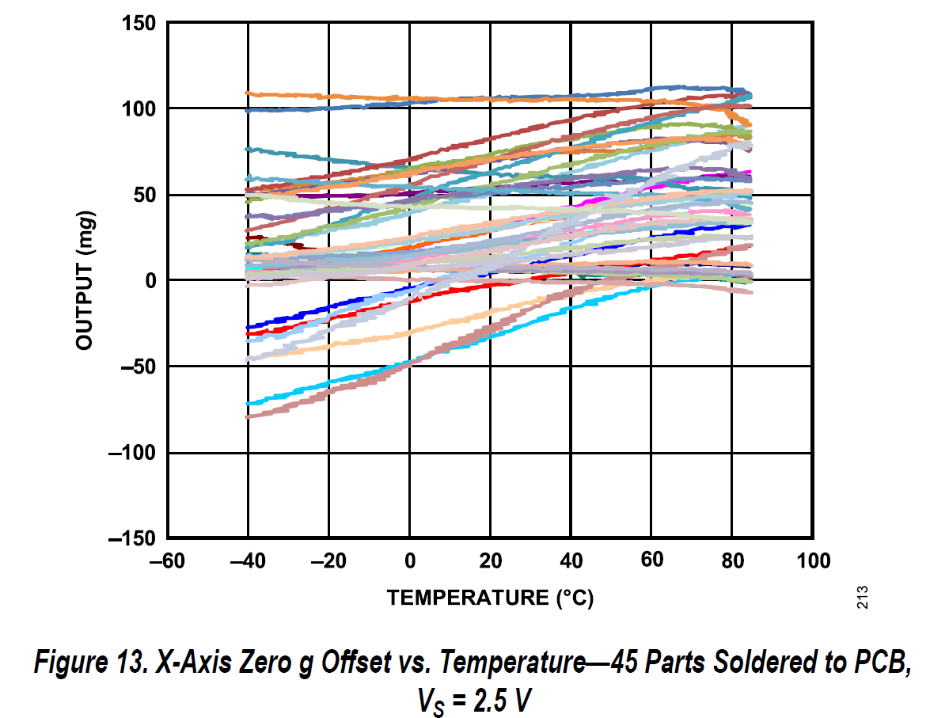
Static Response

Slide 19
Dynamic Response
Response Time
time taken until the sensor output matches a percentage value of the sensor input.
Time Constant
63.2% response time. How fast the sensor reacts to changes in the input.
Rise Time
Time taken to reach a particular value
Settling Time
Time taken to settle to within a percentage of the steady state value

Slide 20
Range and Span
Range
defines the limits between which the input can vary
Span
is the maximum value minus the minimum value
Example
Temperature Sensor Range -45°C to +150°C
Span is 195°C
Your application dictates the required range
If your system will only ever operate in an environment that varies between 23°C and 27°C then get a sensor that works well in that range...

Slide 21
Accuracy
The extent to which the value returned by the sensor might be wrong
Summation of all possible errors that are likely to occur, as well as the 'as supplied' calibration (which could be none)
Typically given as a ± value or percentage
Fundamental and normally most important aspect

Slide 22
Accuracy
Temperature Sensor accuracy of ±2°C
Means that value returned is within ±2°C of actual
+25°C returned could mean anything from 23°C to 27°C
Consider the application
Temperature Sensor, accuracy of ±5% over full range
Range is 0 to +200°C, accuracy is (200*0.05) ±10°C
So at +25°C sensor can return +15°C to +35°C

Slide 23
Accuracy
Learn to be wary of how accuracy is stated
Manufacturers will state numbers in the best light
Which is best?
0-150°C @ ±6°C
0-150°C @ ±5% full scale
69 < 75 < 81°C or 67.5 < 75 < 82.5°C
Be wary of percentages
1% of 1000°C is 10°C, 1% of 100°C is 1°C...
If you are unsure – do the maths…

Slide 24
Error
Error
defined as the difference between the sensor output and the true value of the quantity being read
Returned value is 23°C, true is 21°C error is (23-21) 2°C
Error is sometimes used to describe other aspects of the sensor... better to be specific... detail later!

Slide 25
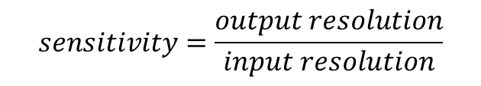
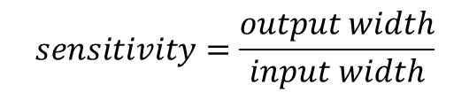
Sensitivity
How much the output changes by when the input changes
Relationship between the output and input:
But can also be used to describe effect on input from environmental changes
Pressure sensor may have a temperature sensitivity of ±0.1% per °C
Assuming fixed output span
Static Response curves with high sensitivity have small input range
Static Response curves with low sensitivity have large input range
$$sensitivity=\frac{output width}{input width}$$
$$sensitivity=\frac{output resolution}{input resolution}$$

Slide 26
Sensitivity
Small input width
Large input width
Fixed Width

Slide 27
Hysteresis
Some sensors can give different readings for the same input depending on the whether the sensor input was increasing or decreasing
Reading is based on the current input as well as the history of inputs
Not necessarily a bad thing, depending on application
...but ideal would be not to have any

Slide 28
Hysteresis

Slide 29

Non-Linearity Error
Normally a linear relationship is assumed between input and output
This is not usually the case, and the maximum difference between the ideal linear relationship and the actual value is the Non-Linearity Error
Typically quoted as a percentage
Non-linearity Error is ±0.05%
Method used to calculate linear relationship
Was the line drawn between the max' and min' values?
Was it drawn through the zero point?
Best fit for a range of points?
Assumed operating point?
$$y=m⋅x+c$$

Slide 30

Repeatability
Ability to give the same output for repeated applications of the same input
Another percentage:
Repeatability is limited by hysteresis and noise
If repeatability is good, then noise and hysteresis must be small
$$repeatability=\frac{max′value−min′value}{fullrange}×100$$

Slide 31
Review
What are sensor specifications?
Parameters
Static and Dynamic Response
Range and Span
Accuracy
Error
Sensitivity
Hysteresis
Non-Linearity Error
Repeatability

Slide 32
References
Please read:
Bernstein, D. S. “A student’s guide to sensor performance specifications”, IEEE Control Systems Magazine, 21, 4, 9-18, 2001
Bernstein, D. S. Sensor Performance Specifications, IEEE Control Systems Magazine, 21, 4, 9-18, 2001
Bolton, W., Mechatronics, 5th Edition, Pearson, 2012
Chapter 2 - Sections 2.1 and 2.2

